Slide 1
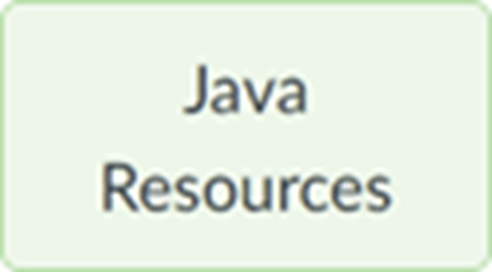
Section 09 (week of Oct 30): Event Handling part 2
We'll start at 5:01 (Tuesday) and 7:16 (Wednesday) Eastern Time.
Pset 3 was due at the start of the lecture 9 week. Pset 4 & Term project proposal are due at start of the lecture 11 week at 9am. See the Notes and term project samples.
Your questions
Swing program structure
Interfaces
Event-driven programming
Listener classes, adapter classes
Events: Action, Window, Mouse, Focus, Keyboard
Drawing 9. Demo illustrating Calculator’s required architecture
Zip file with this section’s slides and sample code is posted to course’s page

Slide 2
Swing program structure
main() instantiates an instance of a class that extends JFrame ¹
That class’s constructor handles layout and “plumbing” to facilitate program’s business logic
Layout: Lays out the JFrame by adding widgets
Plumbing: Adds listeners to widgets, to enable user interaction
Business logic: When the user triggers an event (e.g. clicks a button) the listener runs an event-specific method whose code responds to the event
¹ Dr. Leitner occasionally puts JFrame’s declaration, layout, listener, and business logic in main(). Don’t do that!!!
See HelloWorldV10.java

Slide 3
Interfaces
Java doesn’t do “multiple inheritance” because it’s too complicated
E.g. which parent’s .equals() does the subclass inherit?
An interface is similar to an abstract class. It specifies behavior.
Specifies methods' signatures that a class implementing the interface must provide
It’s like an abstract class's abstract methods
Does not specify instance variables
It can specify static final variables
A class can implement multiple interfaces
His Shape Interface requires implementing classes to have 2 methods:
public double getPerimiter(); • public double getArea();
Shape [] shapes = { new Circle(), new Rectangle(), new Triangle() };
See Shape.java, Circle.java, Rectangle.java, Triangle.java, ShapeDemo.java

Slide 4
Event-driven programming
So far you’ve written linear programs:
Execution starts in main()
When main() is done, the program is done
Event-driven programs respond to “events”
Event Type | Example
Action events | click a button, radio button, checkbox
Window events | window minimized, restored
Mouse events | mouse button pressed, released, clicked (pressed & released)
Focus events | focus gained, lost
Keyboard events | key pressed, released, typed (pressed & released)

Slide 5
Listeners
Listeners are classes that implement a listener-specific interface
Different approaches to structuring listener classes
Approach | Plusses | Minuses
Use the JFrame subclass | Structurally simple | Not readable & one listener must handle every widget’s events
Use inner class(es) | Less unreadable & different widgets can have different listeners | Still unreadable & one listener might still handle several widgets’ events
Use anonymous inner classes | Most readable & each widget has its own listener. | Slight syntactical learning curve
See HelloWorldV10.java, HelloWorldV11.java, HelloWorldV12.java

Slide 6
FooListener v. FooAdapter
A class tasked with processing a Foo event either
Implements the FooListener interface (and all the methods it contains) or
Extends the abstract FooAdapter class (overriding only the methods of interest)
FooAdapter satisfies the compiler because it implements FooListener
And it’s simpler because the user only overrides the methods of interest
We’ll see examples of both approaches in subsequent slides’ sample code.

Slide 7
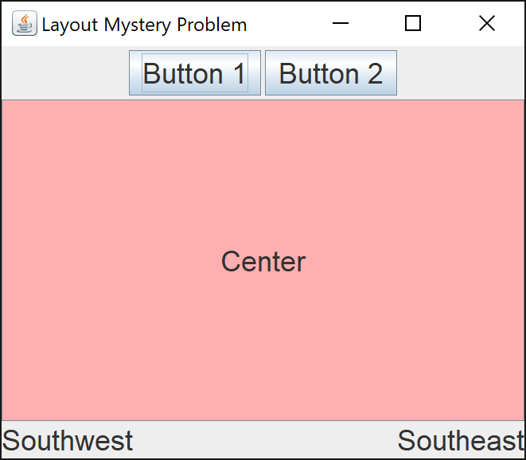
Action Events
See ActionEventsDemo.java

Slide 8
Window events
WindowListener windowListener implements WindowListener {
public void windowOpened( WindowEvent we ) {}
public void windowClosing( WindowEvent we ) {}
public void windowClosed( WindowEvent we ) {}
public void windowIconified( WindowEvent we ) {}
public void windowDeiconified( WindowEvent we ) {}
public void windowActivated( WindowEvent we ) {}
public void windowDeactivated( WindowEvent we ) {}
public void windowGainedFocus( WindowEvent we ) {}
public void windowLostFocus( WindowEvent we ) {}
public void windowStateChanged( WindowEvent we ) {}
} WindowAdapter windowListener extends WindowAdapter { }
See WindowEventsDemoV01.java, WindowEventsDemoV02.java

Slide 9
Mouse events
MouseListener mouseListener implements MouseListener {
public void mouseClicked( MouseEvent me ) {}
public void mouseEntered( MouseEvent me ) {}
public void mouseExited( MouseEvent me ) {}
public void mousePressed( MouseEvent me ) {}
public void mouseReleased( MouseEvent me ) {}
}
MouseAdapter mouseListener extends MouseAdapter { }
See MouseEventsDemoV01.java, MouseEventsDemoV02.java

Slide 10
Focus events
FocusListener focusListener implements FocusListener {
public void focusGained(FocusEvent fe) {}
public void focusLost(FocusEvent fe) {}
}
FocusAdapter focusListener extends FocusAdapter { }
See FocusEventsDemo.java

Slide 11
Keyboard events
KeyListener keyListener implements KeyListener {
public void keyPressed( KeyEvent ke ) { }
public void keyReleased( KeyEvent ke ) { }
public void keyTyped( KeyEvent ke ) { }
}
KeyAdapter keyListener extends KeyAdapter { }
See KeyEventDemo.java

Slide 12
Drawing
Create a class that ...
... extends (“is a”) JPanel
... has a paintComponent instance method
paintComponent NEVER gets called directly. It’s executed when repaint() is called on the class that extends JPanel.
paintComponent receives a Graphics object, provided by Java.
You draw on the JPanel by executing instance methods on that Graphics object.
See DrawingDemo.java

Slide 13
Demo illustrating Calculator’s required architecture
Calculator.java
Creates a CalcBackend object
Lays out the JFrame
Adds action listeners for the JButtons. When actionPerformed runs, it:
Passes a char representing clicked button to CalcBackend’s feedChar(), and then immediately …
Updates displayed String by calling CalcBackend’s getDisplayVal() to get new display String
CalcBackend.java
Constructor initializes calculator’s internal state
feedChar() updates calculator’s internal state, including updating the String that the GUI should display, in response to the char arg representing the latest click
getDisplayVal() just returns the String that the GUI should display
See PrimitiveTypewriter.java, PrimitiveTypewriterBackend.java

